Slide 1


Computer Security: Principles and Practice
Fourth Edition
Chapter 21
Public-Key Cryptography and Message Authentication
Copyright © 2018, 2015, 2012 Pearson Education, Inc. All Rights Reserved
Notes:
This chapter provides technical detail on the topics introduced in Sections 2.2 through 2.4 .

Slide 2
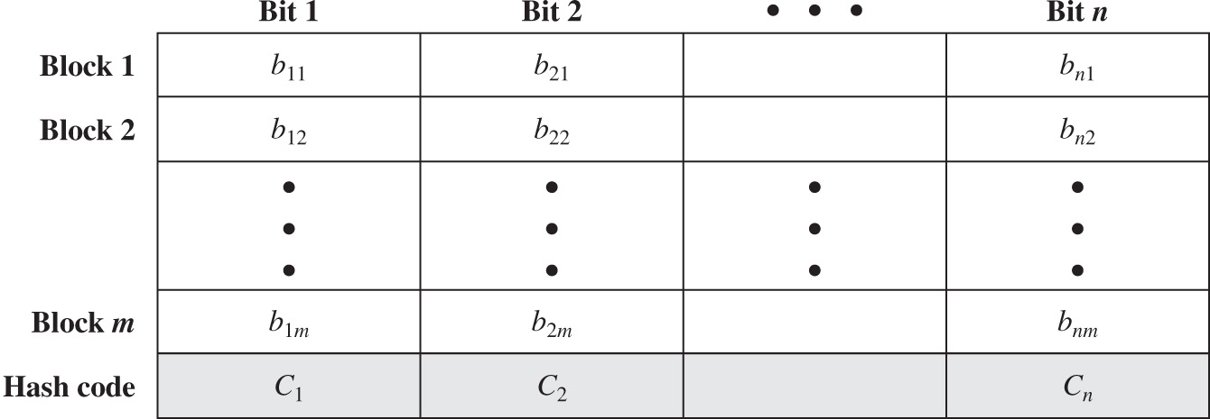
Figure 21.1 Simple Hash Function Using Bitwise X O R
Notes:
The one-way hash function, or secure hash function, is important not only in message authentication but also in digital signatures. The requirements for and security of secure hash functions are discussed in Section 2.2 . Here, we look at several hash functions, concentrating on perhaps the most widely used family of hash functions: SHA.
All hash functions operate using the following general principles. The input (message, file, etc.) is viewed as a sequence of n -bit blocks. The input is processed one block at a time in an iterative fashion to produce an n -bit hash function. One of the simplest hash functions is the bit-by-bit exclusive-OR (XOR) of every block. This can be expressed as follows:
C_{i} = b_{i1} ⊕ b_{i2} ⊕ . . . ⊕ b_{im}
Figure 21.1 illustrates this operation; it produces a simple parity for each bit position and is known as a longitudinal redundancy check. It is reasonably effective for random data as a data integrity check. Each n -bit hash value is equally likely. Thus, the probability that a data error will result in an unchanged hash value is 2-n. With more predictably formatted data, the function is less effective. For example, in most normal text files, the high-order bit of each octet is always zero. So if a 128-bit hash value is used, instead of an effectiveness of 2-128, the hash function on this type of data has an effectiveness of 2-112. The columns have the following headings from left to right. Block, Bit 1, Bit 2, ellipsis, Bit n, . The row entries are as follows. Row 1. 1, b sub 11, b sub 21, Blank, b sub start expression n 1 end expression. Row 2. 2, b sub 12, b sub 22, Blank, b sub start expression n 2 end expression. Row 3. ellipsis, ellipsis, ellipsis, ellipsis, Ellipsis. Row 4. m, b sub start expression 1 m end expression, b sub start expression 2 m end expression, Blank, b sub start expression n m end expression. Row 5. Hash code, C sub 1, C sub 2, Blank, C sub n.

Slide 3
Secure Hash Algorithm (S H A)
S H A was originally developed by N I S T
Published as F I P S 180 in 1993
Was revised in 1995 as S H A-1
Produces 160-bit hash values
N I S T issued revised F I P S 180-2 in 2002
Adds 3 additional versions of S H A
S H A-256, S H A-384, S H A-512
With 256/384/512-bit hash values
Same basic structure as S H A-1 but greater security
The most recent version is F I P S 180-4 which added two variants of S H A-512 with 224-bit and 256-bit hash sizes
Notes:
In recent years, the most widely used hash function has been the Secure Hash Algorithm (SHA). Indeed, because virtually every other widely used hash function had been found to have substantial cryptanalytic weaknesses, SHA was more or less the last remaining standardized hash algorithm by 2005. SHA was developed by the National Institute of Standards and Technology (NIST) and published as FIPS 180 in 1993. When weaknesses were discovered in SHA (now known as SHA-0), a revised version was issued as FIPS 180-1 in 1995 and is referred to as SHA-1 . The actual standards document is entitled “Secure Hash Standard. SHA-1 is also specified in RFC 3174 (US Secure Hash Algorithm 1 (SHA1) , 2001), which essentially duplicates the material in FIPS 180-1 but adds a C code implementation.
SHA-1 produces a hash value of 160 bits. In 2002, NIST produced a revised version of the standard, FIPS 180-2, that defined three new versions of SHA, with hash value lengths of 256, 384, and 512 bits, known as SHA-256, SHA-384, and SHA-512,
respectively (see Table 21.1). Collectively, these hash algorithms are known as SHA-2 . These new versions have the same underlying structure and use the same types of modular arithmetic and logical binary operations as SHA-1. A revised document was issued as FIPS 180-3 in 2008, which added a 224-bit version of SHA-256, whose hash value is obtained by truncating the 256-bit hash value of SHA-256. SHA-1 and SHA-2 are also specified in RFC 6234 (US Secure Hash Algorithms (SHA and SHA-based HMAC and HKDF ), 2011), which essentially duplicates the material in FIPS 180-3 but adds a C code implementation. The most recent version is FIPS 180-4 [Secure Hash Standard (SHS) , August 2015] which added two variants of SHA-512 with 224-bit and 256-bit hash sizes, as SHA-512 is more efficient than SHA-256 on many 64-bit systems.
In 2005, NIST announced the intention to phase out approval of SHA-1 and move to a reliance on SHA-2 by 2010. Shortly thereafter, a research team described an attack in which two separate messages could be found that deliver the same SHA-1 hash using 2⁶⁹ operations, far fewer than the 2⁸⁰ operations previously thought needed to find a collision with an SHA-1 hash [WANG05]. This result has hastened the transition to SHA-2.
In this section, we provide a description of SHA-512. The other versions are quite similar. The algorithm takes as input a message with a maximum length of less than 2 ¹²⁸ bits and produces as output a 512-bit message digest. The input is processed in 1024-bit blocks.

Slide 4
Table 21.1 Comparison of S H A Parameters
Blank | S H A-1 | S H A-224 | S H A-256 | S H A-384 | S H A-512 | S H A-512/224 | S H A-512/256
Message size | is less than 2 to the 64 power | is less than 2 to the 64 power | is less than 2 to the 64 power | is less than 2 to the 128 power | is less than 2 to the 128 power | is less than 2 to the 128 power | is less than 2 to the 128 power
Word size | 32 | 32 | 32 | 64 | 64 | 64 | 64
Block size | 512 | 512 | 512 | 1024 | 1024 | 1024 | 1024
Message digest size | 160 | 224 | 256 | 384 | 512 | 224 | 256
Number of steps | 80 | 64 | 64 | 80 | 80 | 80 | 80
Security | 80 | 112 | 128 | 192 | 256 | 112 | 128
Notes:
All sizes are measured in bits
Security refers to the fact that a birthday attack on a message digest of size n produces a collision with a work
factor of approximately
Notes:
Table 21.1 Comparison of SHA parameters.

Slide 5
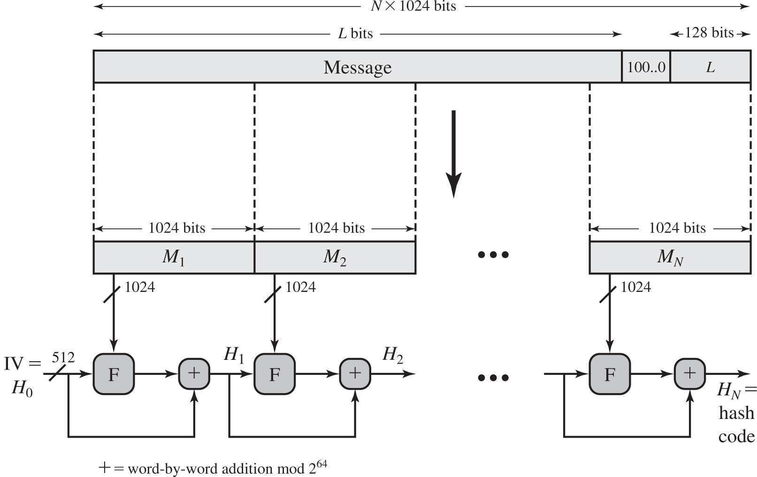
Figure 21.2 Message Digest Generation Using S H A-512
Notes:
Figure 21.2 depicts the overall processing of a message to produce a digest. The processing consists of the following steps:
• Step 1: Append padding bits: so that message length is congruent to 896 modulo 1024 [length ≡ 896 (mod 1024)]. The padding consists of a single 1-bit followed by the necessary number of 0-bits.
• Step 2: Append length: as a block of 128 bits being an unsigned 128-bit integer length of the original message (before padding).
• Step 3: Initialize hash buffer: A 512-bit buffer is used to hold intermediate and final results of the hash function. The buffer can be represented as eight 64-bit registers (a, b, c, d, e, f, g, h).
• Step 4: Process the message in 1024-bit (128-word) blocks, The heart of the algorithm is a module that consists of 80 rounds; this module is labeled F in Figure 21.2.
• Step 5: Output. After all N 1024-bit blocks have been processed, the output from the N th stage is the 512-bit message digest.
A message of L bits is padded with bits, numbering in range of 1 to 1024, so that its length is congruent is N times 1024 bits. The bits consist of a single 1 bit followed by number of 0 bits. A 128 bit block is appended to the message. The outcome of the first two steps yields a message that is an integer multiple of 1024 bits in length. The expanded message is represented as the sequence of 1024-bit blocks, in sequence from M sub 1 to M sub N. An initialization vector H sub 0 with 512 bits buffers are added to the message. Each round takes as input the 512 bit buffer value and updates the contents of the buffer. The hash code obtained is H sub N.

Slide 6
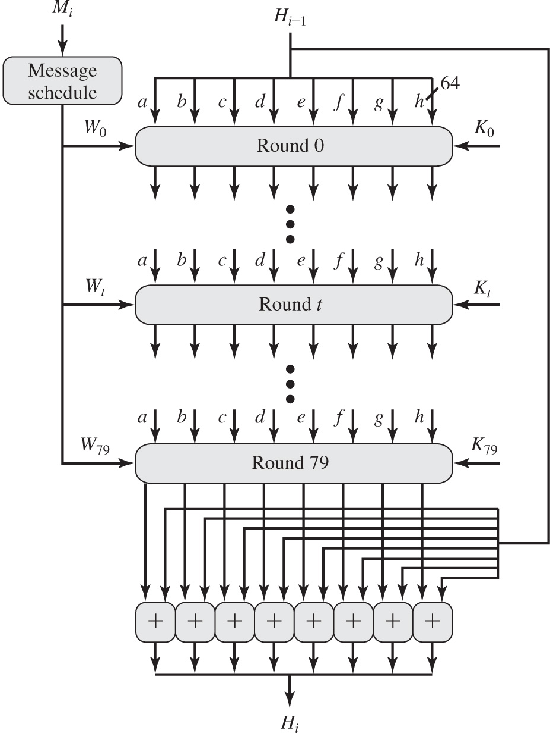
Figure 21.3 S H A-512 Processing of a Single 1024-Bit Block
Notes:
The logic is illustrated in Figure 21.3.
Each round takes as input the 512-bit buffer value abcdefgh, and updates the contents of the buffer. At input to the first round, the buffer has the value of the intermediate hash value, Hi–1. Each round t makes use of a 64-bit value Wt, derived from the current 1024-bit block being processed (Mi). Each round also makes use of an additive constant Kt, where 0 ≤ t ≤ 79 indicates one of the 80 rounds. These words represent the first sixty-four bits of the fractional parts of the cube roots of the first eighty prime numbers. The constants provide a “randomized” set of 64-bit patterns, which should eliminate any regularities in the input data. The operations performed during a round consist of circular shifts, and primitive Boolean functions based on AND, OR, NOT, and XOR.
The output of the eightieth round is added to the input to the first round (Hi–1) to produce Hi. The addition is done independently for each of the eight words in the buffer with each of the corresponding words in Hi–1, using addition modulo 264.
The SHA-512 algorithm has the property that every bit of the hash code is a function of every bit of the input. The complex repetition of the basic function F produces results that are well mixed; that is, it is unlikely that two messages chosen at
random, even if they exhibit similar regularities, will have the same hash code. Unless there is some hidden weakness in SHA-512, which has not so far been published, the difficulty of coming up with two messages having the same message digest is on the order of 2256 operations, while the difficulty of finding a message with a given digest is on the order of 2512 operations.
The message schedule M sub i is processed for 80 rounds to produce H sub i. Each round takes as input the 512 bit buffer value, a b c d e f g h, and updates the contents of the buffer. At input to the first round, the buffer has the value of the intermediate hash value, H sub start expression i minus 1 end expression. Each round t makes use of a 64 bit value W sub t, derived from the current 1024 bit block being processed M sub i. Each round also makes use of an additive constant K sub t, where 0 to 79 indicates one of the 80 rounds. The constants provide a randomized set of 64 bit patterns. The output of the eightieth round is added to the input to the first round, H sub start expression i minus 1 end expression to produce H sub i. The addition is done independently for each of the eight words in the buffer with each of the corresponding words in sub start expression i minus 1 end expression, using addition modulo 2 to the 64 power.

Slide 7
H M A C
Interest in developing a M A C derived from a cryptographic hash code
Cryptographic hash functions generally execute faster
Library code is widely available
S H A-1 was not deigned for use as a M A C because it does not rely on a secret key
Issued as R F C2014
Has been chosen as the mandatory-to-implement M A C for I P security
Used in other Internet protocols such as Transport Layer Security (T L S) and Secure Electronic Transaction (S E T)
Notes:
In this section, we look at the hash-code approach to message authentication. Appendix E looks at message authentication based on block ciphers. In recent years, there has been increased interest in developing a MAC derived from a cryptographic hash code, such as SHA-1. The motivations for this interest are as follows:
• Cryptographic hash functions generally execute faster in software than conventional encryption algorithms such as DES.
• Library code for cryptographic hash functions is widely available.
A hash function such as SHA-1 was not designed for use as a MAC and cannot be used directly for that purpose because it does not rely on a secret key. There have been a number of proposals for the incorporation of a secret key into an existing hash algorithm. The approach that has received the most support is HMAC [BELL96]. HMAC has been issued as RFC 2104 (HMAC: Keyed-Hashing for Message Authentication , 1997), has been chosen as the mandatory-to-implement MAC for IP Security, and is used in other Internet protocols, such as Transport Layer Security (TLS, soon to replace Secure Sockets Layer) and Secure Electronic Transaction (SET).

Slide 8
H M A C Design Objectives
To use, without modifications, available hash functions
To allow for easy replaceability of the embedded hash function in case faster or more secure hash functions are found or required
To preserve the original performance of the hash function without incurring a significant degradation
To use and handle keys in a simple way
To have a well-understood cryptographic analysis of the strength of the authentication mechanism based on reasonable assumptions on the embedded hash function
Notes:
RFC 2104 lists the following design objectives for HMAC:
• To use, without modifications, available hash functions—in particular, hash functions that perform well in software, and for which code is freely and widely available
• To allow for easy replaceability of the embedded hash function in case faster or more secure hash functions are found or required
• To preserve the original performance of the hash function without incurring a significant degradation
• To use and handle keys in a simple way
• To have a well-understood cryptographic analysis of the strength of the authentication mechanism based on reasonable assumptions on the embedded hash function
The first two objectives are important to the acceptability of HMAC. HMAC treats the hash function as a “black box.” This has two benefits. First, an existing implementation of a hash function can be used as a module in implementing HMAC. In this way, the bulk of the HMAC code is prepackaged and ready to use without modification. Second, if it is ever desired to replace a given hash function in an HMAC implementation, all that is required is to remove the existing hash function module and drop in the new module. This could be done if a faster hash function were desired. More important, if the security of the embedded hash function were compromised, the security of HMAC could be retained simply by replacing the embedded hash function with a more secure one.
The last design objective in the preceding list is, in fact, the main advantage of HMAC over other proposed hash-based schemes. HMAC can be proven secure provided that the embedded hash function has some reasonable cryptographic
strengths. We return to this point later in this section, but first we examine the structure of HMAC.

Slide 9
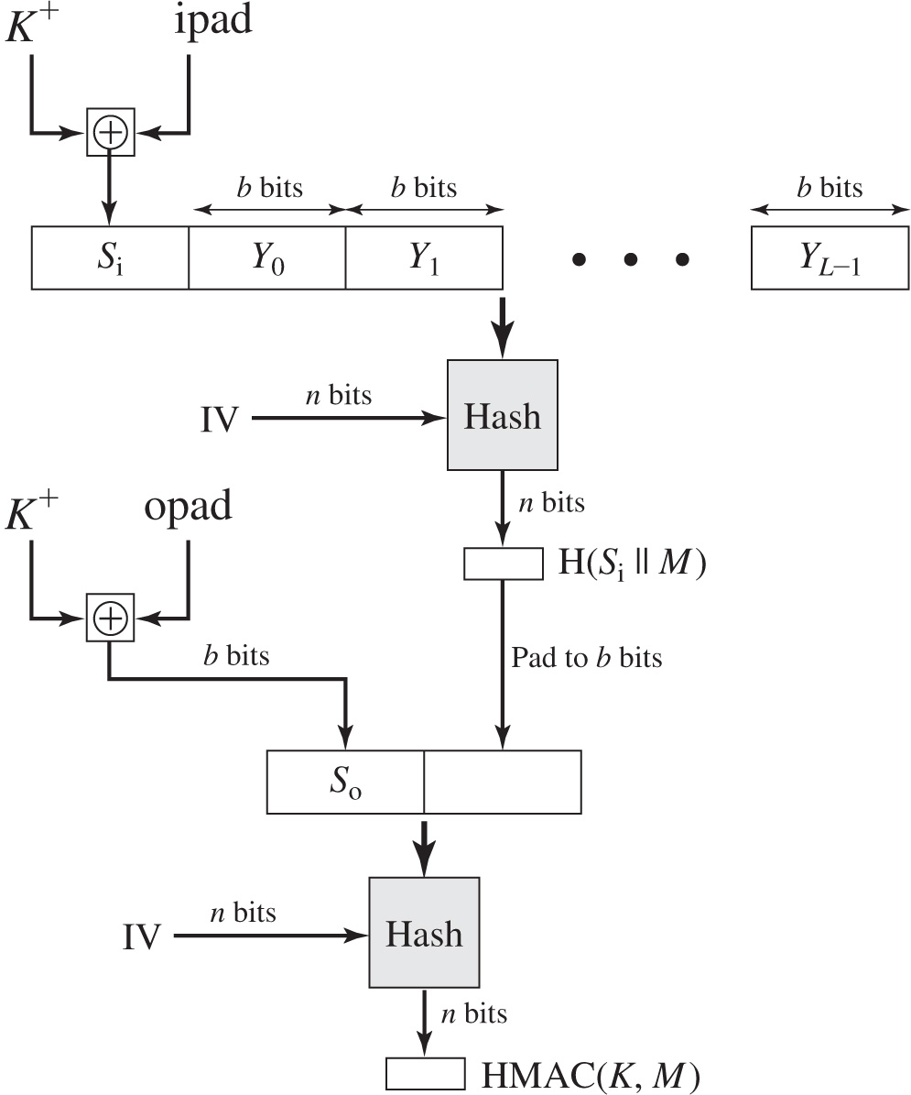
Figure 21.4 H M A C Structure
Notes:
Figure 21.4 illustrates the overall operation of HMAC.
In words:
1. Append zeros to the left end of K to create a b-bit string K+ (e.g., if K is of length 160 bits and b = 512, then K will be appended with 44 zero bytes 0x00).
2. XOR (bitwise exclusive-OR) K+ with ipad to produce the b-bit block Si.
3. Append M to Si.
4. Apply H to the stream generated in step 3.
5. XOR K+ with opad to produce the b-bit block So.
6. Append the hash result from step 4 to So.
7. Apply H to the stream generated in step 6 and output the result.
Note that the XOR with ipad results in flipping one-half of the bits of K . Similarly, the XOR with opad results in flipping one-half of the bits of K , but a different set of bits. In effect, by passing S i and S o through the hash algorithm, we have pseudorandomly generated two keys from K .
HMAC should execute in approximately the same time as the embedded hash function for long messages. HMAC adds three executions of the basic hash function (for S i , S o , and the block produced from the inner hash).
The process is as follows. 1. Append zeros to the left end of K to create a b bit string K + 2. X O R, bitwise exclusive O R, K + with i pad to produce the b bit block S sub i. 3. Append Y sub 0 and Y sub 1, to Y sub start expression L minus 1 end expression each of b bits, to S sub i. 4. Apply H to the stream generated in step 3. 5. X O R K + with o pad to produce the b bit block S sub o. 6. Append the hash result from step 4 to S sub o. 7. Apply H to the stream generated in step 6 and output the result. The X O R with i pad results in flipping one half of the bits of K. Similarly, the X O R with o pad results in flipping one half of the bits of K, but a different set of bits. In effect, pass S sub i and S sub o through the hash algorithm to get the pseudo randomly generated two keys from K. H M A C adds three executions of the basic hash function, for S sub i, S sub o, and the block produced from the inner hash.

Slide 10
R S A Public-Key Encryption
By Rivest, Shamir & Adleman of M I T in 1977
Best known and widely used public-key algorithm
Uses exponentiation of integers modulo a prime
Encrypt:
Decrypt:
Both sender and receiver know values of n and e
Only receiver knows value of d
Public-key encryption algorithm with public key
Notes:
Perhaps the most widely used public-key algorithms are RSA and Diffie-Hellman.
One of the first public-key schemes was developed in 1977 by Ron Rivest, Adi Shamir, and Len Adleman at MIT and first published in 1978 [RIVE78]. The RSA scheme has since that time reigned supreme as the most widely accepted and implemented approach to public-key encryption. RSA is a block cipher in which the plaintext and ciphertext are integers between 0 and n – 1 for some n.
Encryption and decryption are of the following form, for some plaintext block M and ciphertext block C:
C = Me mod n
M = C^{d} mod n = (Me)^{d} mod n = M^{ed} mod n
Both sender and receiver must know the values of n and e, and only the receiver knows the value of d. This is a public-key encryption algorithm with a public key of PU = {e, n} and a private key of PR = {d, n}. See text for details of how these values are derived, and their requirements.

Slide 11
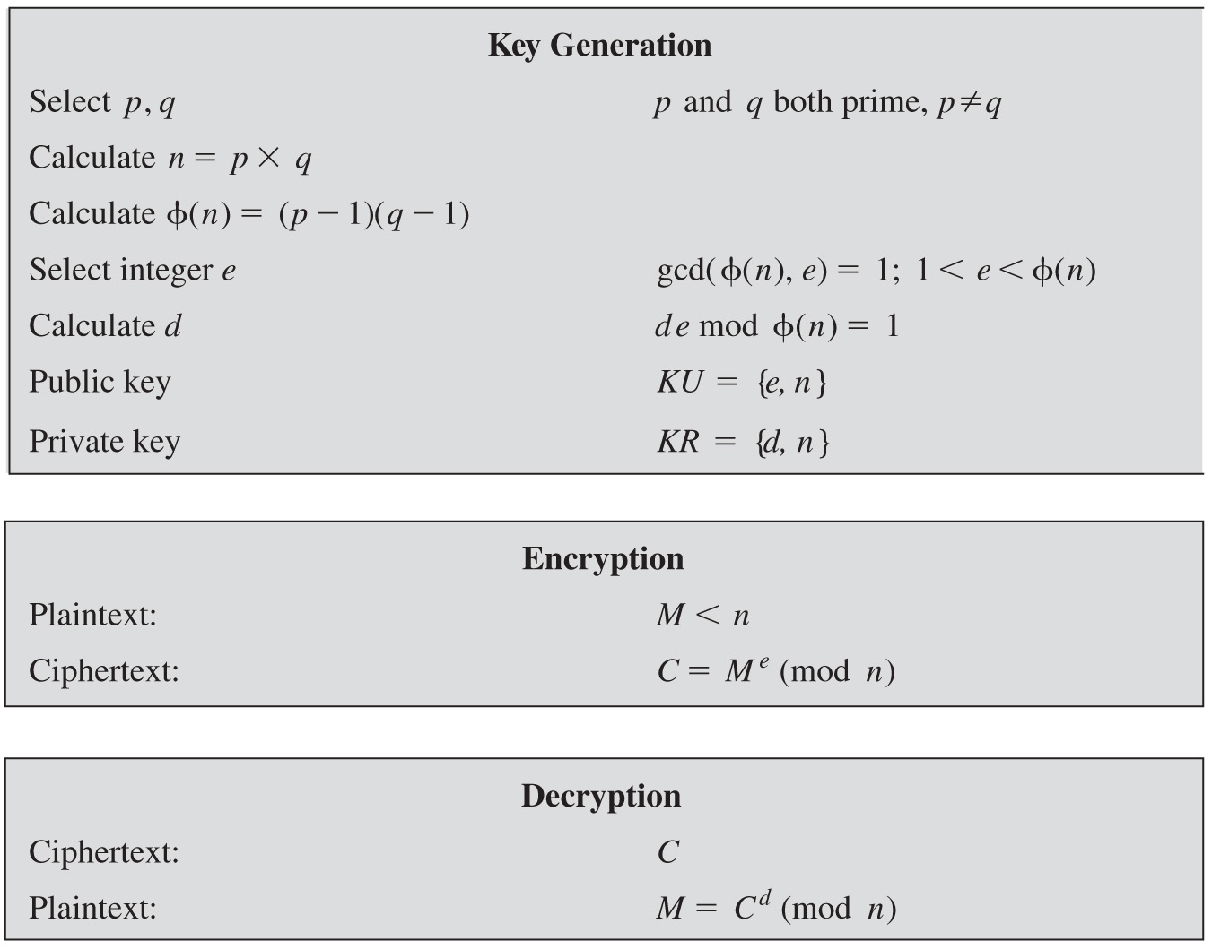
Figure 21.7 The R S A Algorithm
Notes:
Figure 21.7 summarizes the RSA algorithm. Key generation. Select p, q p and q both prime, p does not equal q. Calculate n = p times q. Calculate phi left parenthesis n right parenthesis = left parenthesis p minus 1 right parenthesis left parenthesis q minus 1 right parenthesis. Select integer e, g c d left parenthesis phi left parenthesis n right parenthesis, e right parenthesis = 1, 1 is less than e and e is less than phi left parenthesis n right parenthesis. Calculate d, d e, m o d phi left parenthesis n right parenthesis = 1. Public key K U = left brace e, n right brace. Private key K R = left brace d, n right brace. Encryption. Plaintext, M is less than n. Cipher text, C = M to the e power left parenthesis m o d, n right parenthesis. Decryption. Ciphertext, C. Plaintext, M = C to the d power left parenthesis m o d, n right parenthesis.

Slide 12
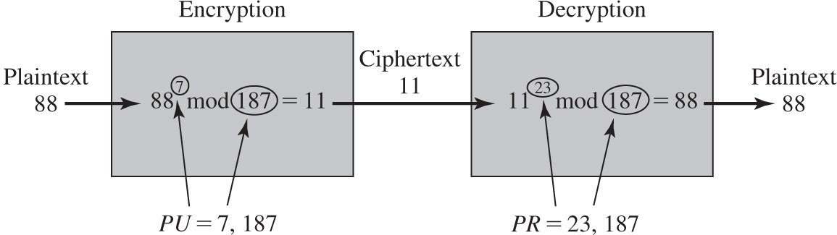
Figure 21.8 Example of R S A Algorithm
Notes:
An example, from [SING99], is shown in Figure 21.8. Encryption. Plaintext 88 is given as input. 88 to the 7 power m o d 187, where P U = 7, 87, = 11. Ciphertext 11 is the output. Decryption. Cipher text 88 is decrypted. 11 to the 23 power m o d 187, where P R = 23, 187. Plaintext 88 is the output.

Slide 13
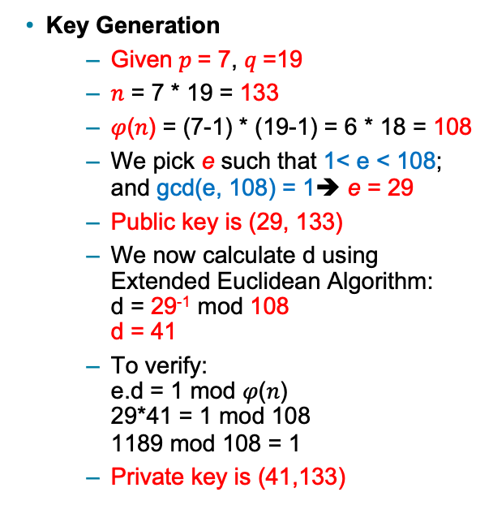
Calculating d using Extended Euclidean Algorithm
Extended Euclidean Algorithm
Initialization: A= 𝜑(𝑛), B=e, T₀=0, T₁=1
For the row calculate: Q= Quotient of A/B R= Remainder of A/B T = T₁ – T₂ * Q
if R=0 then d=T₂ STOP else populate the next row: A=B B=R T₁ =T2 T2=T
Go back to step 2
Key Generation
Given $p$= 7, $q$=19
𝑛 = 7 * 19 = 133
𝜑(𝑛) = (7-1) * (19-1) = 6 * 18 = 108
We pick e such that 1< e < 108; and gcd(e, 108) = 1➔ e = 29
Public key is (29, 133)
We now calculate d using Extended Euclidean Algorithm: d = 29⁻¹ mod 108 d = 41
To verify: e.d = 1 mod 𝜑(𝑛) 29*41 = 1 mod 108 1189 mod 108 = 1
Private key is (41,133)
Q | A | B | R | T₁ | T₂ | T
3 | 108 | 29 | 21 | 0 | 1 | -3
1 | 29 | 21 | 8 | 1 | -3 | 4
2 | 21 | 8 | 5 | -3 | 4 | -11
1 | 8 | 5 | 3 | 4 | -11 | 15
1 | 5 | 3 | 2 | -11 | 15 | -26
1 | 3 | 2 | 1 | 15 | -26 | 41
2 | 2 | 1 | 0 | -26 | 41 | -108
 |  |  | STOP |  | d

Slide 14
Encryption in RSA with public key (29,133)
Encryption of M = 99
C = 99²⁹ mod 133
We take the power 29 = (11101)_{b} ←→ 16, 8, 4, 2, 1
Now we have 99²⁹= 99¹⁶ * 99⁸ * 99⁴ * 99¹
99¹ mod 133 = 99
99² mod 133 = 92
99⁴ mod 133 = (99²)² mod 133 =92² mod 133 = 85
99⁸ mod 133 = 85² mod 133 = 43
99¹⁶ mod 133 = 43² mod 133 = 120
So, 99²⁹ mod 133 = (120*43*85*99) mod 133 = 43421400 mod 133 = 92

Slide 15
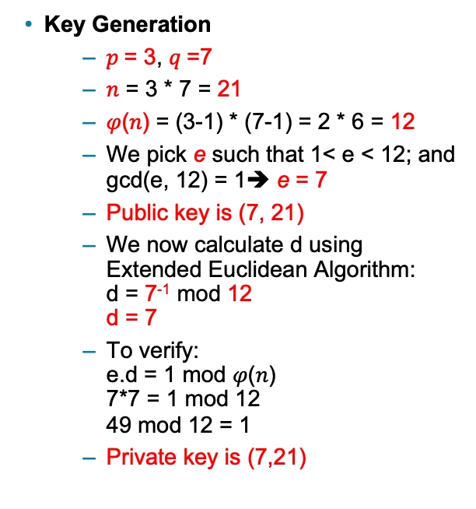
Another RSA Example
Key Generation
$p$= 3, $q$=7
𝑛 = 3 * 7 = 21
𝜑(𝑛) = (3-1) * (7-1) = 2 * 6 = 12
We pick e such that 1< e < 12; and gcd(e, 12) = 1➔ e = 7
Public key is (7, 21)
We now calculate d using Extended Euclidean Algorithm: d = 7⁻¹ mod 12 d = 7
To verify: e.d = 1 mod 𝜑(𝑛) 7*7 = 1 mod 12 49 mod 12 = 1
Private key is (7,21)
Extended Euclidean Algorithm
A > B
Q: Quotient, R: Remainder
T₁ initialized with 0, T₂ initialized with 1
T = T₁ – T₂ * Q
Q | A | B | R | T₁ | T₂ | T
1 | 12 | 7 | 5 | 0 | 1 | -1
1 | 7 | 5 | 2 | 1 | -1 | 2
2 | 5 | 2 | 1 | -1 | 2 | -5
2 | 2 | 1 | 0 | 2 | -5
 |  |  | STOP |  | d
-5 mod 12 = (-5+12) mod 12 = 7 mod 12
Hence, d = 7
BAD Selection of p and q since e = d

Slide 16
Security of R S A
Brute force
Involves trying all possible private keys
Mathematical attacks
There are several approaches, all equivalent in effort to factoring the product of two primes
Timing attacks
These depend on the running time of the decryption algorithm
Chosen ciphertext attacks
This type of attack exploits properties of the R S A algorithm
Notes:
Four possible approaches to attacking the RSA algorithm are:
• Brute force: This involves trying all possible private keys.
• Mathematical attacks: There are several approaches, all equivalent in effort to factoring the product of two primes.
• Timing attacks: These depend on the running time of the decryption algorithm.
• Chosen ciphertext attacks: This type of attack exploits properties of the RSA algorithm. A discussion of this attack is beyond the scope of this book.

Slide 17
Table 21.2 Progress in Factorization
Number of Decimal Digits | Number of Bits | Date Achieved
100 | 332 | April 1991
110 | 365 | April 1992
120 | 398 | June 1993
129 | 428 | April 1994
130 | 431 | April 1996
140 | 465 | February 1999
155 | 512 | August 1999
160 | 530 | April 2003
174 | 576 | December 2003
200 | 663 | May 2005
193 | 640 | November 2005
232 | 768 | December 2009
Notes:
For a large n with large prime factors, factoring is a hard problem, but not as hard as it used to be. Just as it had done for DES, RSA Laboratories issued challenges for the RSA cipher with key sizes of 100, 110, 120, and so on, digits. The
latest challenge to be met is the RSA-200 challenge with a key length of 200 decimal digits, or about 663 bits. Table 21.2 shows the results to date. The level of effort is measured in MIPS-years: a million-instructions-per-second processor running for one year, which is about 3 * 10¹³ instructions executed (MIPS-year numbers not available for last 3 entries).
A striking fact about Table 21.2 concerns the method used. Until the mid-1990s, factoring attacks were made using an approach known as the quadratic sieve. The attack on RSA-130 used a newer algorithm, the generalized number field
sieve (GNFS), and was able to factor a larger number than RSA-129 at only 20% of the computing effort.
The threat to larger key sizes is twofold: the continuing increase in computing power, and the continuing refinement of factoring algorithms. We have seen that the move to a different algorithm resulted in a tremendous speedup. We can
expect further refinements in the GNFS, and the use of an even better algorithm is also a possibility. In fact, a related algorithm, the special number field sieve (SNFS), can factor numbers with a specialized form considerably faster than the generalized number field sieve. It is reasonable to expect a breakthrough that would enable a general factoring performance in about the same time as SNFS, or even better. Thus, we need to be careful in choosing a key size for RSA. For the near future, a key size in the range of 1024 to 2048 bits seems secure.
In addition to specifying the size of n , a number of other constraints have been suggested by researchers. To avoid values of n that may be factored more easily, the algorithm’s inventors suggest the following constraints on p and q :
1. p and q should differ in length by only a few digits. Thus, for a 1024-bit key (309 decimal digits), both p and q should be on the order of magnitude of 10 ⁷⁵ to 10 ¹⁰⁰ .
2. Both (p - 1) and (q - 1) should contain a large prime factor.
3. gcd (p - 1, q - 1) should be small.
In addition, it has been demonstrated that if e < n and d < n^{1/4} , then d can be easily determined [WIEN90].

Slide 18
Timing Attacks
Paul Kocher, a cryptographic consultant, demonstrated that a snooper can determine a private key by keeping track of how long a computer takes to decipher messages
Timing attacks are applicable not just to R S A, but also to other public-key cryptography systems
This attack is alarming for two reasons:
It comes from a completely unexpected direction
It is a ciphertext-only attack
Notes:
If one needed yet another lesson about how difficult it is to assess the security of a cryptographic algorithm, the appearance of timing attacks provides a stunning one. Paul Kocher, a cryptographic consultant, demonstrated that a snooper can determine a private key by keeping track of how long a computer takes to decipher messages [KOCH96]. Timing attacks are applicable not just to RSA, but also to other public-key cryptography systems. This attack is alarming for two reasons: It comes from a completely unexpected direction, and it is a ciphertext-only attack.
A timing attack is somewhat analogous to a burglar guessing the combination of a safe by observing how long it takes for someone to turn the dial from number to number. The attack exploits the common use of a modular exponentiation algorithm in RSA encryption and decryption, but the attack can be adapted to work with any implementation that does not run in fixed time. In the modular exponentiation algorithm, exponentiation is accomplished bit by bit, with one modular multiplication performed at each iteration and an additional modular multiplication performed for each 1 bit.
As Kocher points out in his paper, the attack is simplest to understand in an extreme case. Suppose the target system uses a modular multiplication function that is very fast in almost all cases but in a few cases takes much more time than an entire average modular exponentiation. The attack proceeds bit-by-bit starting with the leftmost bit, b_{k} .
Therefore, if the observed time to execute the decryption algorithm is always slow when this particular iteration is slow with a 1 bit, then this bit is assumed to be 1. If a number of observed execution times for the entire algorithm are fast, then this bit is assumed to be 0.
In practice, modular exponentiation implementations do not have such extreme timing variations, in which the execution time of a single iteration can exceed the mean execution time of the entire algorithm. Nevertheless, there is enough variation to make this attack practical. For details, see [KOCH96].

Slide 19
Timing Attack Countermeasures
Constant exponentiation time
Ensure that all exponentiations take the same amount of time before returning a result
This is a simple fix but does degrade performance
Random delay
Better performance could be achieved by adding a random delay to the exponentiation algorithm to confuse the timing attack
If defenders do not add enough noise, attackers could still succeed by collecting additional measurements to compensate for the random delays
Blinding
Multiply the ciphertext by a random number before performing exponentiation
This process prevents the attacker from knowing what ciphertext bits are being processed inside the computer and therefore prevents the bit-by-bit analysis essential to the timing attack
Notes:
• Constant exponentiation time: Ensure that all exponentiations take the same amount of time before returning a result. This is a simple fix but does degrade performance.
• Random delay: Better performance could be achieved by adding a random delay to the exponentiation algorithm to confuse the timing attack. Kocher points out that if defenders do not add enough noise, attackers could still succeed by collecting additional measurements to compensate for the random delays.
• Blinding: Multiply the ciphertext by a random number before performing exponentiation. This process prevents the attacker from knowing what ciphertext bits are being processed inside the computer and therefore prevents the
bit-by-bit analysis essential to the timing attack.

Slide 20
Diffie-Hellman Key Exchange
First published public-key algorithm
By Diffie and Hellman in 1976 along with the exposition of public key concepts
Used in a number of commercial products
Practical method to exchange a secret key securely that can then be used for subsequent encryption of messages
Security relies on difficulty of computing discrete logarithms
Notes:
The first published public-key algorithm appeared in the seminal paper by Diffie and Hellman that defined public-key cryptography [DIFF76] and is generally referred to as Diffie-Hellman key exchange. A number of commercial products
employ this key exchange technique.
The purpose of the algorithm is to enable two users to exchange a secret key securely that can then be used for subsequent encryption of messages. The algorithm itself is limited to the exchange of the keys.
The Diffie-Hellman algorithm depends for its effectiveness on the difficulty of computing discrete logarithms.

Slide 21
Diffie-Hellman key exchange
The most described implementation of DH key exchange uses the keys of the ElGamal cipher system and a very simple function F. The system parameters (which are public) are:
p which is a large prime number – typically 1024 bits in length
g which is a primitive root modulo p
g is a primitive root modulo p if for every integer a coprime to p, there is some integer k for which g^{k} ≡ a mod p.
Alice generates a private random value a, calculates gª (mod p) and sends it to Bob.
Bob generates a private random value b, calculates g^{b} (mod p) and sends it to Alice.
Alice takes g^{b} and her private random value a to compute (g^{b})ª = g^{ab} (mod p).
Bob takes gª and his private random value b to compute (gª)^{b} = g^{ab} (mod p).
Alice and Bob adopt g^{ab} (mod p) as the shared secret.

Slide 22
Diffie-Hellman- Example
Alice and Bob publicly agree to use a modulus p = 23 and base g = 5 (which is a primitive root modulo 23).
Alice chooses a secret integer a = 4, then sends Bob A = gª mod p
A = 5⁴ mod 23 = 4
Bob chooses a secret integer b = 3, then sends Alice B = g^{b} mod p
B = 5³ mod 23 = 10
Alice computes s = Bª mod p
s = 10⁴ mod 23 = 18
Bob computes s = A^{b} mod p
s = 4³ mod 23 = 18
Alice and Bob now share a secret (the number 18).

Slide 23
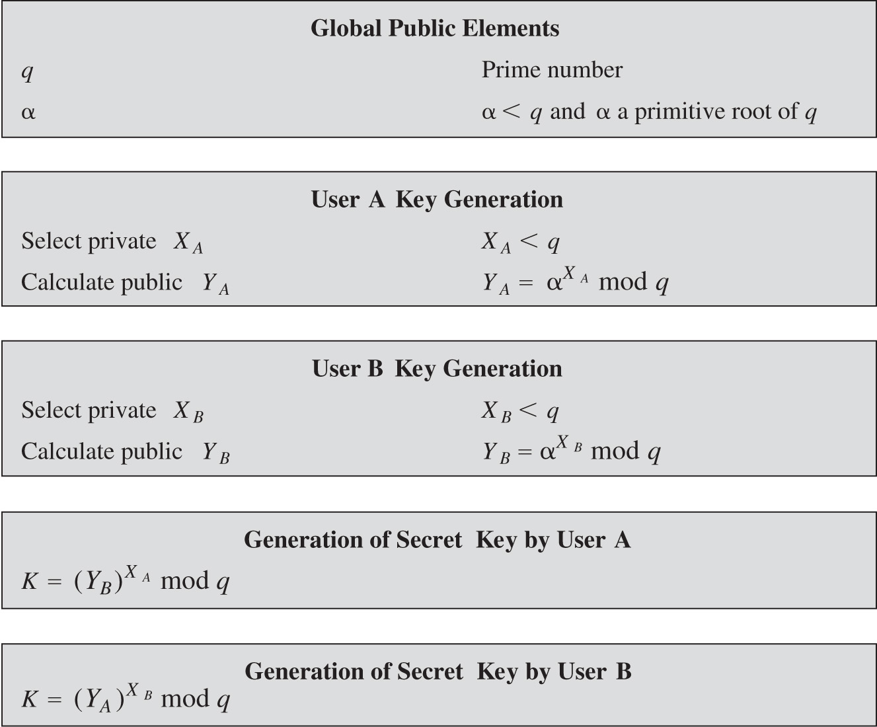
Figure 21.9 The Diffie-Hellman Key Exchange Algorithm
Notes:
The Diffie-Hellman key exchange algorithm is summarized in Figure 21.9. For this scheme, there are two publicly known numbers: a prime number q and an integer α that is a primitive root of q. Suppose the users A and B wish to exchange a key. User A selects a random integer X_{A} < q and computes . Similarly, user B independently selects a random integer X_{B} < q and computes . Each side keeps the X value private and makes the Y value available publicly to the other side. Users A and B compute the key as shown. These two calculations produce identical results, as shown in the text. The result is that the two sides have exchanged a secret value.
Furthermore, because X_{A} and X_{B} are private, an adversary only has the following ingredients to work with: q, α, Y_{A}, and Y_{B}. Thus, the adversary is forced to take a discrete logarithm to determine the key. For example, to determine the private key of user B, an adversary must compute: X_{B} = dlog_{α,q}(Y_{B}). The adversary can then calculate the key K in the same manner as user B calculates it.
The security of the Diffie-Hellman key exchange lies in the fact that, while it is relatively easy to calculate exponentials modulo a prime, it is very difficult to calculate discrete logarithms. For large primes, the latter task is considered infeasible.
Global public elements. q, prime number. alpha, alpha is less than q and alpha a primitive root of q. User A key generation. Select private X sub A, X sub A is less than q. Calculate public Y sub A, Y sub A = alpha to the X sub A power m o d q. User B key generation. Select private X sub B, X sub B is less than q. Calculate public Y sub B, Y sub B = alpha to the X sub B power m o d q. Generation of secret key by User A. k = left parenthesis Y sub B right parenthesis to the X sub A power m o d q. Generation of secret key by User B. k = left parenthesis Y sub A right parenthesis to the X sub B power m o d q.

Slide 24
Another Diffie-Hellman Example
Have
Prime number q = 353
Primitive root
A and B each compute their public keys
A computes
B computes
Then exchange and compute secret key:
For A:
For B
Attacker must solve:
Desired answer is 97, then compute key as B does
Notes:
The security of the Diffie-Hellman key exchange lies in the fact that, while it is relatively easy to calculate exponentials modulo a prime, it is very difficult to calculate discrete logarithms. For large primes, the latter task is considered infeasible
Here is an example. Key exchange is based on the use of the prime number q = 353 and a primitive root of 353, in this case α = 3. A and B select secret keys X_{A} = 97 and X_{B} = 233, respectively. Each computes its public key:
A computes Y_{A} = 3⁹⁷ mod 353 = 40.
B computes Y_{B} = 3²³³ mod 353 = 248.
After they exchange public keys, each can compute the common secret key:
A computes K = (Y_{B})^{XA} mod 353 = 248⁹⁷ mod 353 = 160.
B computes K = (Y_{A})^{XB} mod 353 = 40²³³ mod 353 = 160.
We assume an attacker would have available the following information:
q = 353; α = 3; Y_{A} = 40; Y_{B} = 248
In this simple example, it would be possible by brute force to determine the secret key 160. In particular, an attacker E can determine the common key by discovering a solution to the equation 3ª mod 353 = 40 or the equation 3^{b} mod 353 = 248. The brute-force approach is to calculate powers of 3 modulo 353, stopping when the result equals either 40 or 248. The desired answer is reached with the exponent value of 97, which provides 3⁹⁷ mod 353 = 40.
With larger numbers, the problem becomes impractical.

Slide 25
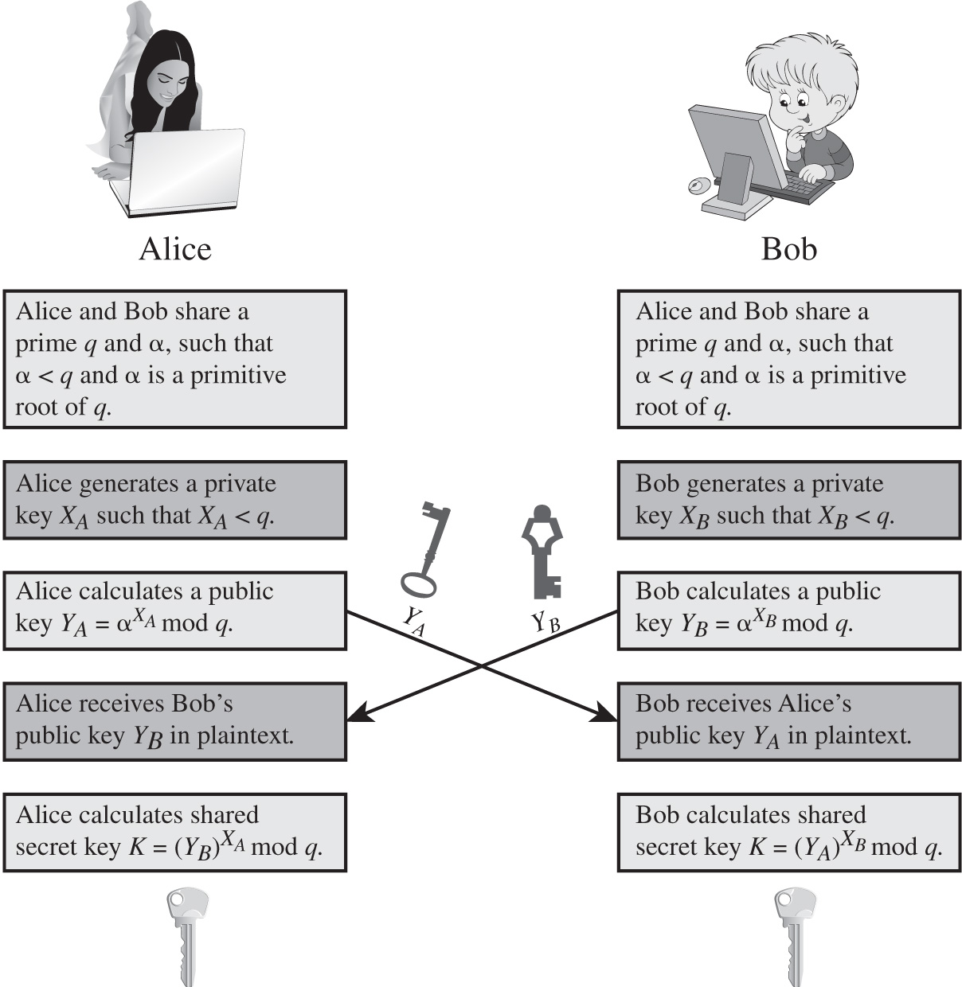
Figure 21.10 Diffie-Hellman Key Exchange
Notes:
Figure 21.10 shows a simple protocol that makes use of the Diffie-Hellman calculation. Suppose that user A wishes to set up a connection with user B and use a secret key to encrypt messages on that connection. User A can generate a one-time private key X_{A}, calculate Y_{A}, and send that to user B. User B responds by generating a private value X_{B}, calculating Y_{B}, and sending Y_{B} to user A. Both users can now calculate the key. The necessary public values q and α would need to be known ahead of time. Alternatively, user A could pick values for q and α and include those in the first message.
As an example of another use of the Diffie-Hellman algorithm, suppose that a group of users (e.g., all users on a LAN) each generate a long-lasting private value X_{A} and calculate a public value Y_{A}. These public values, together with global public values for q and α, are stored in some central directory. At any time, user B can access user A's public value, calculate a secret key, and use that to send an encrypted message to user A. If the central directory is trusted, then this form of communication provides both confidentiality and a degree of authentication. Because only A and B can determine the key, no other user can read the message (confidentiality). Recipient A knows that only user B could have created a message using this key (authentication). However, the technique does not protect against replay attacks.
Two users Alice and Bob share a prime q and alpha, such that alpha is less than q and alpha is a primitive root of q. Alice generates a private key X sub A such that X sub A is less than q. Bob generates a private key X sub B such that X sub B is less than q. Bob calculates a public key Y sub B = alpha to the X sub B power m o d q. Alice calculates a public key Y sub A = alpha to the X sub A power m o d q. The keys are exchanged. Alice recieves Bob's public key Y sub B in plaintext. Bob receives Alice's public key Y sub A in plaintext. Alice calculates shared secret key K = left parenthesis Y sub B right parenthesis to the X sub A power m o d q. Bob calculates shared secret key K = left parenthesis Y sub A right parenthesis X sub B m o d q.

Slide 26

Man-in-the-Middle Attack
Attack is:
Darth generates private keys
and their public keys
Alice transmits
Darth intercepts
and transmits
Darth also calculates K2
Bob receives
and calculates K1
Bob transmits
to Alice
Darth intercepts
and transmits
to Alice. Darth calculates K1
Alice receives
and calculates K2
All subsequent communications compromised
Notes:
The protocol depicted in Figure 21.10 is insecure against a man-in-the-middle attack. Suppose Alice and Bob wish to exchange keys, and Darth is attacks as follows:
1. Darth generates two private keys X_{D1} and X_{D2}, and public keys Y_{D1} & Y_{D2}.
2. Alice transmits Y_{A} to Bob.
3. Darth intercepts Y_{A} and transmits Y_{D1} to Bob. Darth also calculates K2
4. Bob receives Y_{D1} and calculates K1.
5. Bob transmits X_{A} to Alice.
6. Darth intercepts X_{A} and transmits Y_{D2} to Alice. Darth calculates .
7. Alice receives Y_{D2} and calculates .
At this point, Bob and Alice think that they share a secret key, but instead Bob and Darth share secret key K1 and Alice and Darth share secret key K2. All future communication between Bob and Alice is compromised in the following way:
1. Alice sends an encrypted message M: E(K2, M).
2. Darth intercepts the encrypted message and decrypts it, to recover M.
3. Darth sends Bob E(K1, M) or E(K1, M'), where M' is any message. In the first case, Darth simply wants to eavesdrop on the communication without altering it. In the second case, Darth wants to modify the message going to Bob.
The key exchange protocol is vulnerable to such an attack because it does not authenticate the participants. This vulnerability can be overcome with the use of digital signatures and public-key certificates.

Slide 27
Summary
Secure hash functions
Simple hash functions
The S H A secure hash function
S H A-3
Diffie-Hellman and other asymmetric algorithms
Diffie-Helman key exchange
Other public-key cryptography algorithms
Authenticated encryption
The R S A public-key encryption algorithm
Description of the algorithm
The security of R S A
H M A C
H M A C design objectives
H M A C algorithm
Security of H M A C
Notes:
Chapter 21 summary.

Slide 28

Copyright
This work is protected by United States copyright laws and is provided solely for the use of instructors in teaching their courses and assessing student learning. Dissemination or sale of any part of this work (including on the World Wide Web) will destroy the integrity of the work and is not permitted. The work and materials from it should never be made available to students except by instructors using the accompanying text in their classes. All recipients of this work are expected to abide by these restrictions and to honor the intended pedagogical purposes and the needs of other instructors who rely on these materials.

